Slide 1


Lidiia Khashina
22/11/2024

Slide 2

Outline
Executive Summary
Introduction
Methodology
Results
Conclusion
Appendix

Slide 3
Executive Summary
Summary of methodologies
- Data Collection using SpaceX API
- Data Collection with Web Scraping
- Data Wrangling
- Exploratory Data Analysis using SQL
- Data Visualization with Python Pandas and Matplotlib
- Visual Analytics with Folium and Ploty Dash
- Machine Learning Landing Prediction with Classifiaction
Summary of all results
Decision Tree has better accuracy than SVM, KNN and Logistic Regression

Slide 4
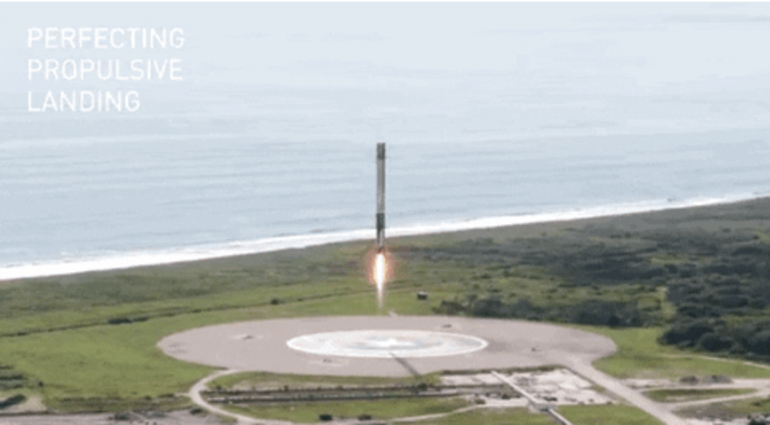
Introduction
In this capstone, we will predict if the Falcon 9 first stage will land successfully. SpaceX advertises Falcon 9 rocket launches on its website with a cost of 62 million dollars; other providers cost upward of 165 million dollars each, much of the savings is because SpaceX can reuse the first stage. Therefore if we can determine if the first stage will land, we can determine the cost of a launch. This information can be used if an alternate company wants to bid against SpaceX for a rocket launch. In this lab, you will collect and make sure the data is in the correct format from an API. The following is an example of a successful and launch.

Slide 5

Section 1

Slide 6
Methodology
Executive Summary
Data collection methodology:
Describe how data was collected
Perform data wrangling
Describe how data was processed
Perform exploratory data analysis (EDA) using visualization and SQL
Perform interactive visual analytics using Folium and Plotly Dash
Perform predictive analysis using classification models
How to build, tune, evaluate classification models

Slide 7
Data Collection
Data was initially collected using the SpaceX API, which is a RESTful API. This was accomplished by making a GET request to the SpaceX API after defining several helper functions. These functions facilitated the extraction of information from the launch data using identification numbers.
To ensure consistency in the requested JSON results, we queried the SpaceX launch data through a GET request, decoded the response content into JSON format, and then converted the data into a Pandas DataFrame.
In addition to using the API, web scraping was performed to gather historical launch records for Falcon 9 from a Wikipedia page titled "List of Falcon 9 and Falcon Heavy launches." The launch records were stored in an HTML table. Using the BeautifulSoup and requests libraries, I extracted the Falcon 9 launch data from the HTML table, parsed it, and then converted it into a Pandas DataFrame.

Slide 8
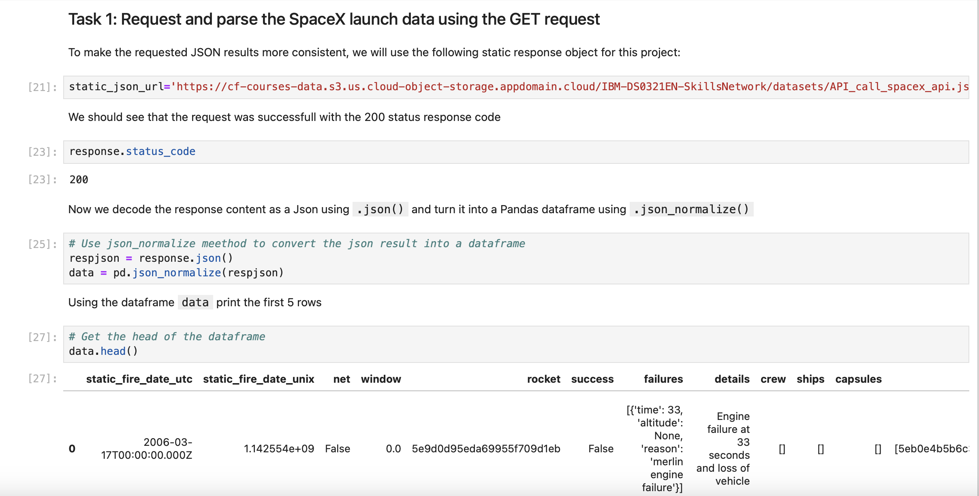
Data Collection – SpaceX API
Data was collected using the SpaceX API, a RESTful API, by making a GET request to retrieve information about SpaceX launches. The response was parsed and the content was decoded into JSON format. This data was then converted into a Pandas DataFrame for further analysis.
https://github.com/adatheleader/falcon9/blob/main/jupyter-labs-spacex-data-collection-api-v2.ipynb

Slide 9
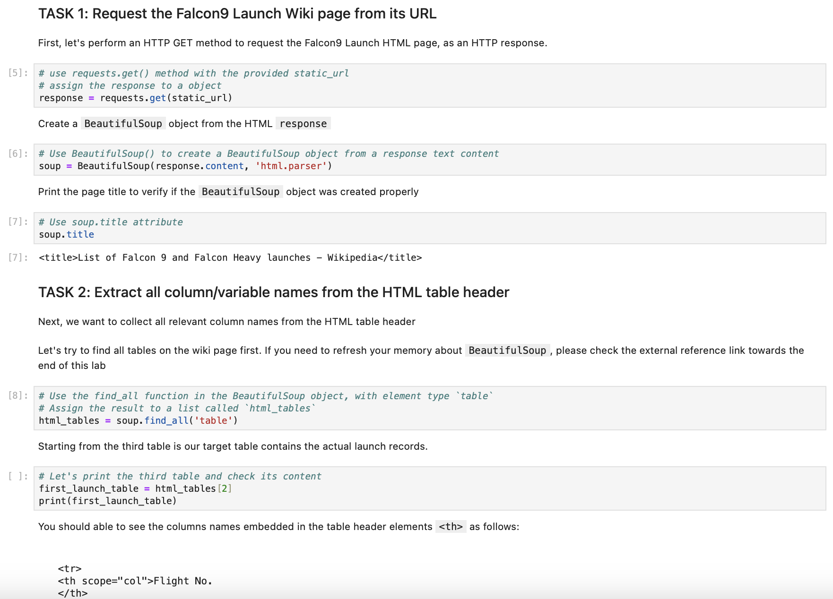
Data Collection - Scraping
I performed web scraping to collect historical launch records of the Falcon 9 from Wikipedia. Using BeautifulSoup and the Requests library, I extracted the launch records from the HTML table on the Wikipedia page and then created a data frame by parsing the launch data from the HTML.
https://github.com/adatheleader/falcon9/blob/main/jupyter-labs-webscraping.ipynb
Place your flowchart of web scraping here

Slide 10
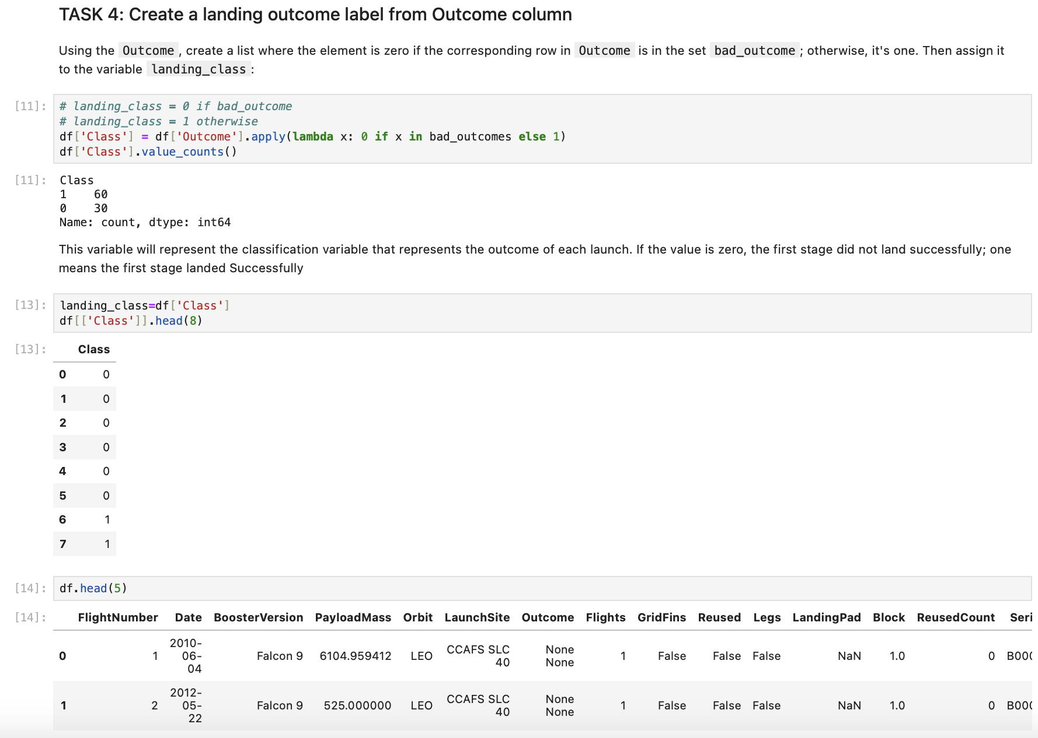
Data Wrangling
After obtaining and creating a Pandas DataFrame from the collected data, I filtered the data using the BoosterVersion column to keep only the Falcon 9 launches. Next, I addressed the missing values in the LandingPad and PayloadMass columns. For the PayloadMass, I replaced the missing values with the mean of the column. Additionally, I conducted Exploratory Data Analysis (EDA) to identify patterns in the data and to determine a suitable label for training supervised models.
https://github.com/adatheleader/falcon9/blob/main/labs-jupyter-spacex-Data%20wrangling.ipynb

Slide 11
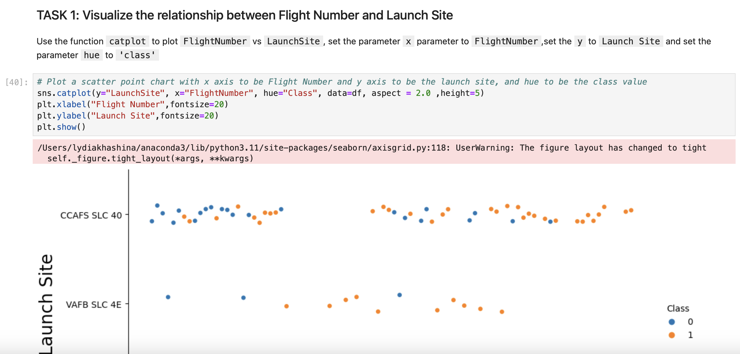
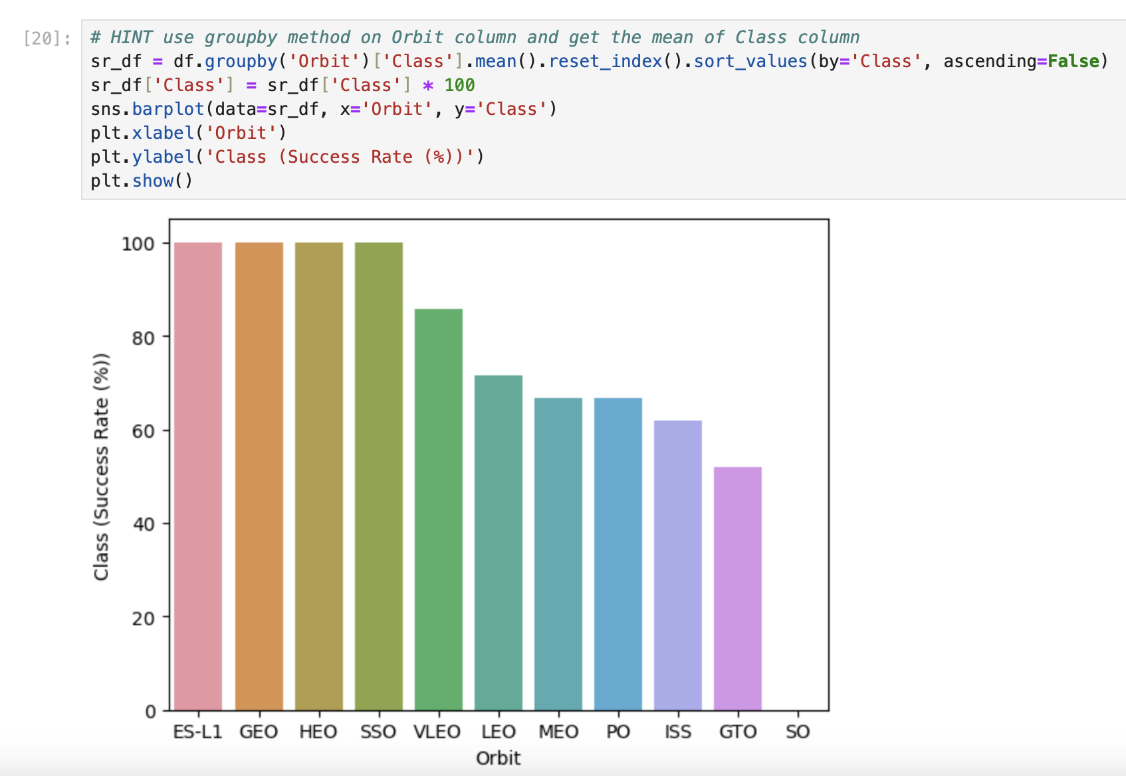
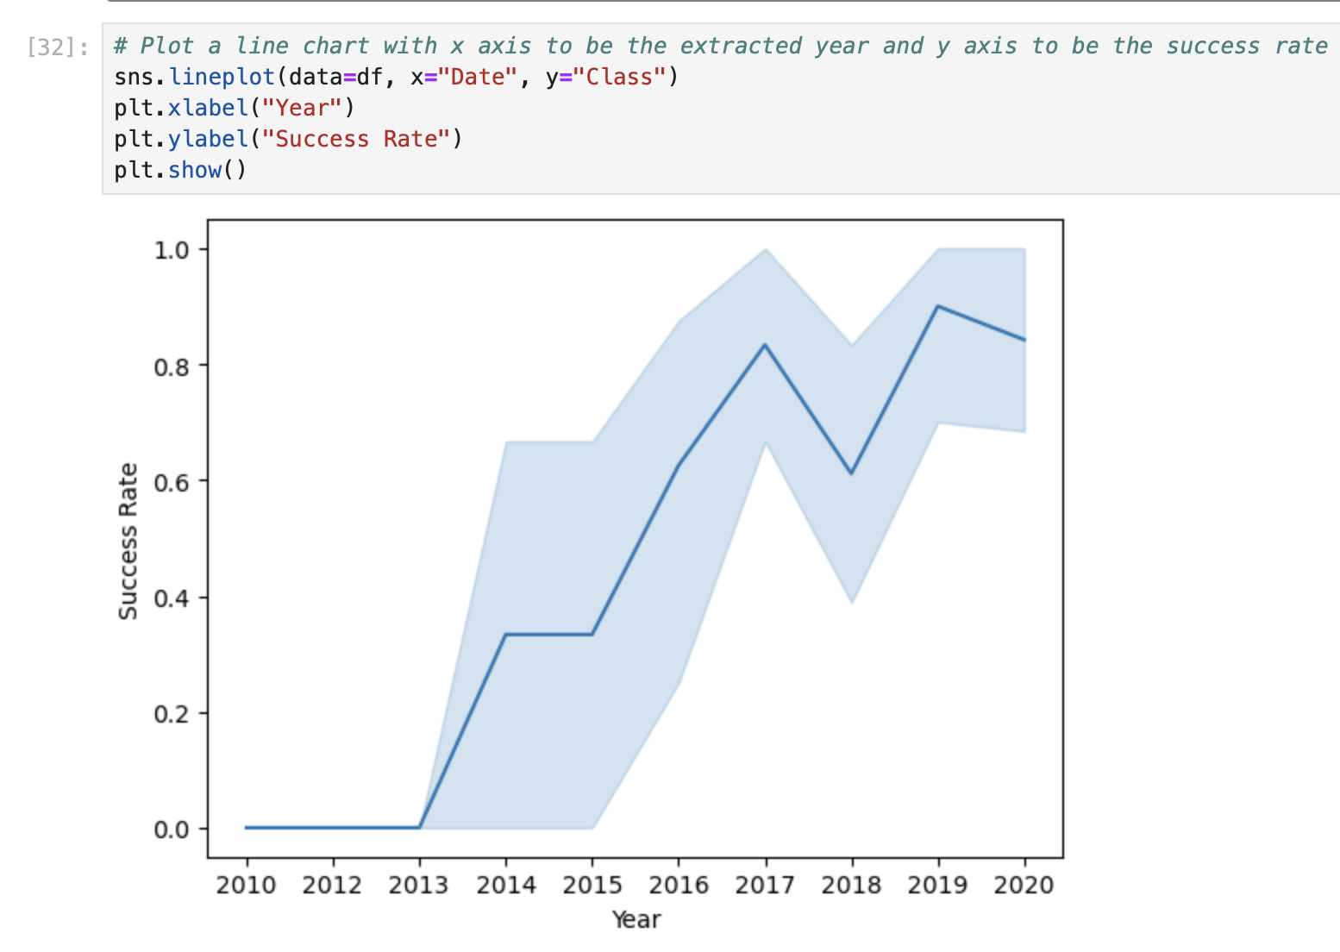
EDA with Data Visualization
I conducted data analysis and feature engineering using Pandas and Matplotlib. Specifically, I utilized scatter plots to visualize the relationships between flight number and launch site, payload and launch site, flight number and orbit type, as well as payload and orbit type. Additionally, I employed bar charts to illustrate the success rates of each orbit type and created a line plot to display the yearly trend in launch success.
https://github.com/adatheleader/falcon9/blob/main/jupyter-labs-eda-dataviz-v2.ipynb

Slide 12
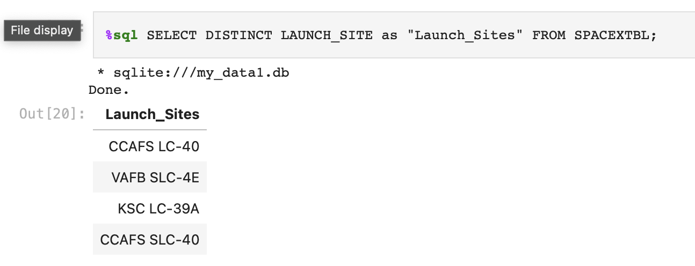
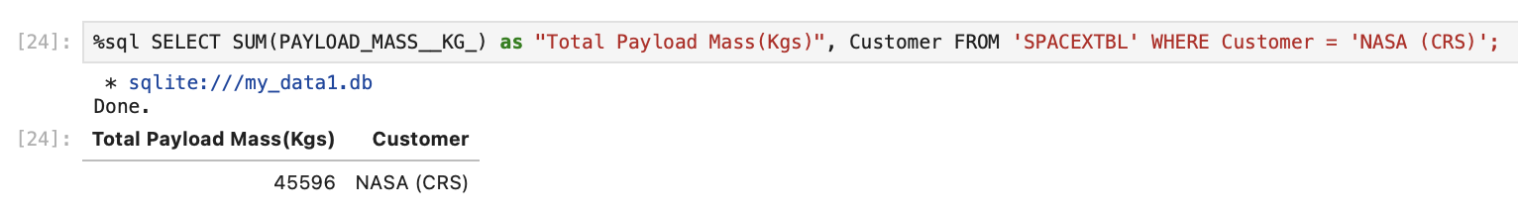
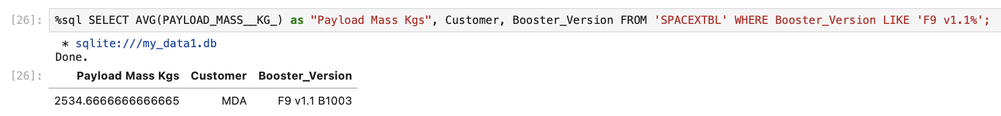
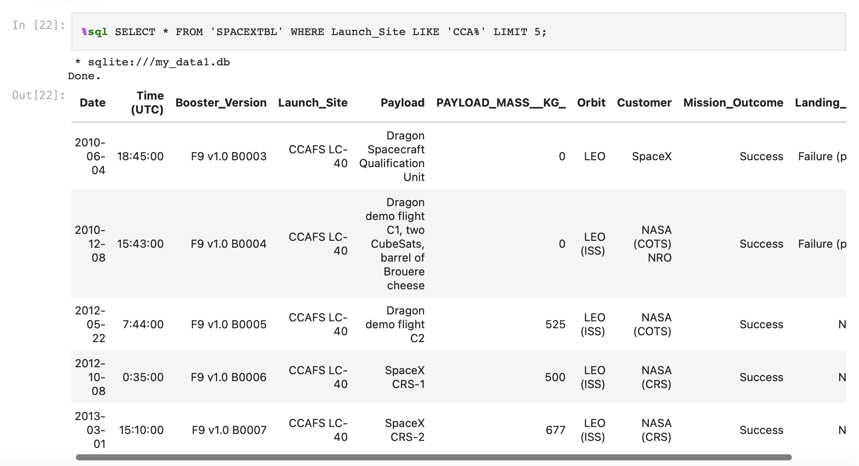
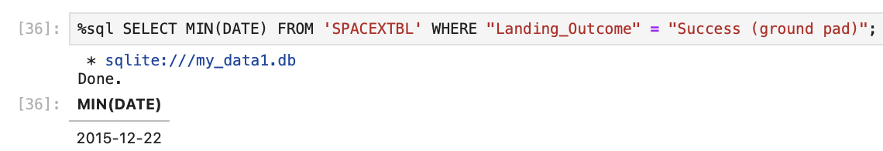
EDA with SQL
Display the names of the unique launch sites in the space mission
Display 5 records where launch sites begin with the string 'CCA‘
Display the total payload mass carried by boosters launched by NASA (CRS)
Display the total payload mass carried by boosters launched by NASA (CRS)
Display average payload mass carried by booster version F9 v1.1
List the date when the first successful landing outcome in ground pad was achieved
https://github.com/adatheleader/falcon9/blob/main/jupyter-labs-eda-sql-coursera_sqllite.ipynb

Slide 13
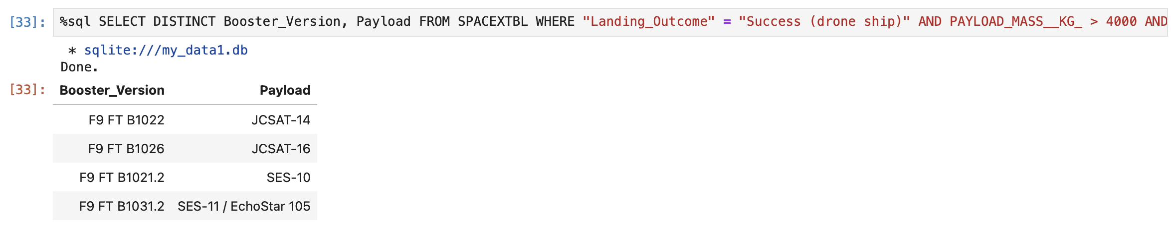
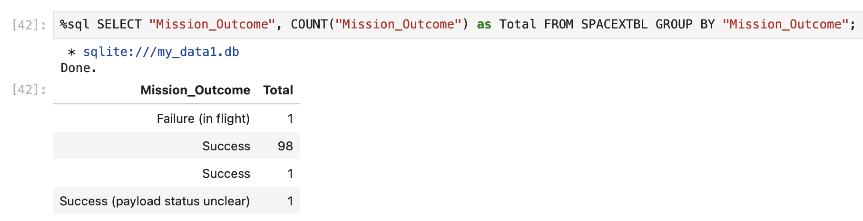
EDA with SQL (continued)
List the names of the boosters which have success in drone ship and have payload mass greater than 4000 but less than 6000
List the total number of successful and failure mission outcomes
https://github.com/adatheleader/falcon9/blob/main/jupyter-labs-eda-sql-coursera_sqllite.ipynb

Slide 14
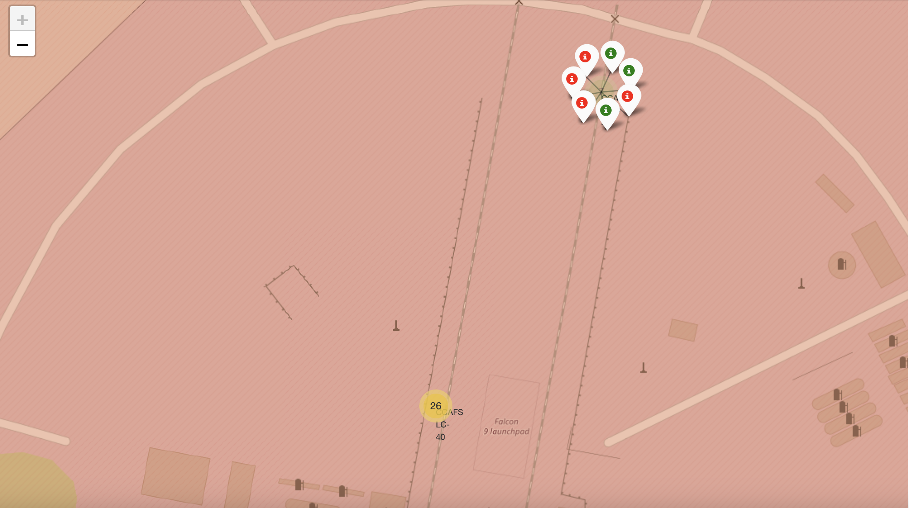
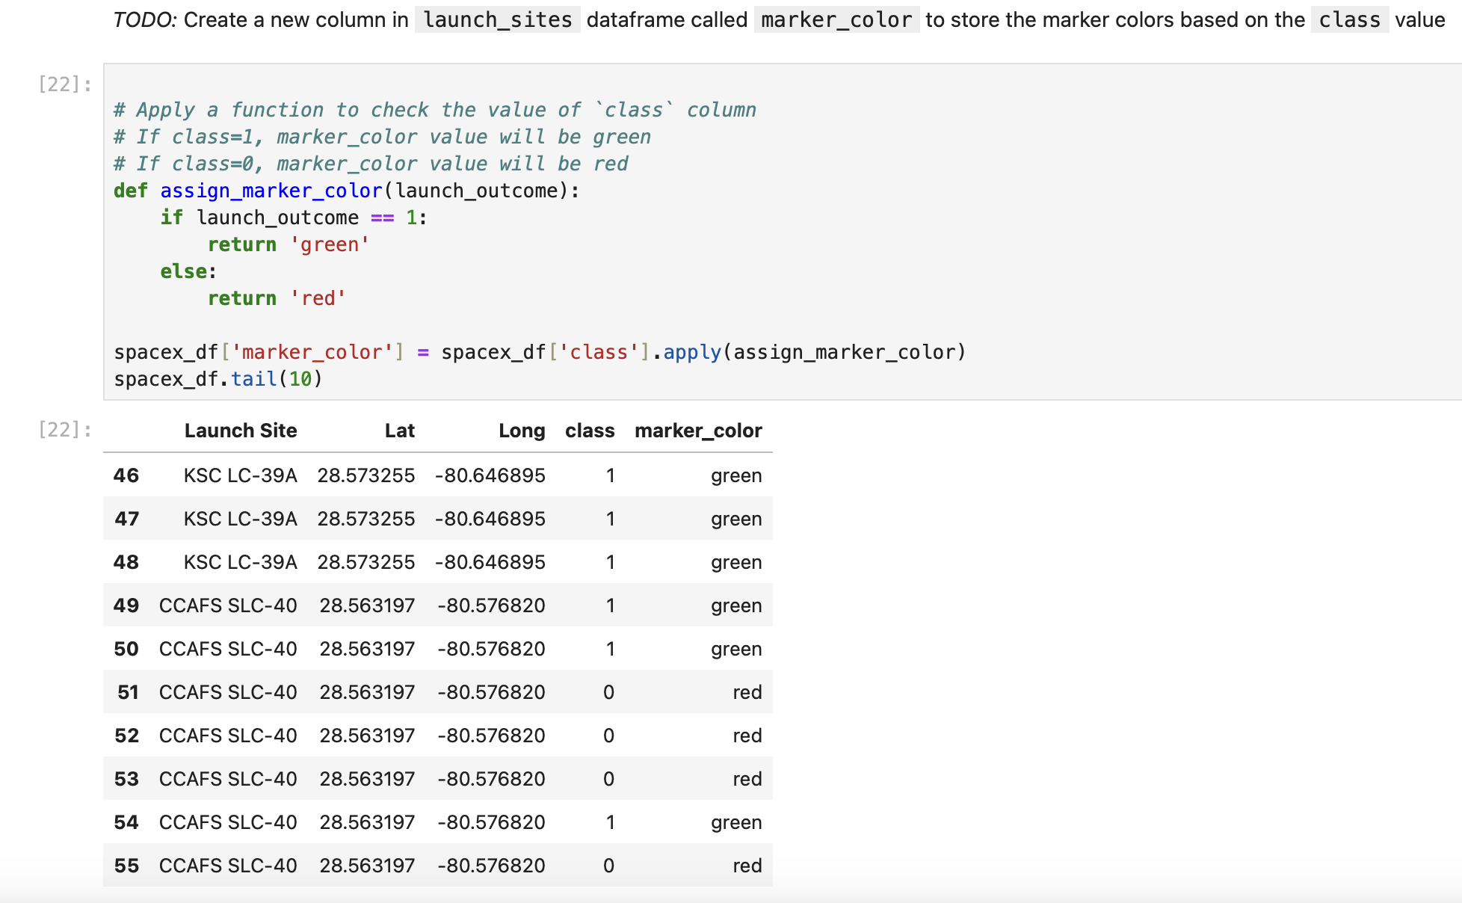
Build an Interactive Map with Folium
Created a Folium map to mark all the launch sites and to create map objects such as markers, circles, and lines to indicate the success or failure of launches for each launch site. A launch outcome dataset was created with values for failure (0) and success (1).
https://github.com/adatheleader/falcon9/blob/main/lab-jupyter-launch-site-location-v2.ipynb

Slide 15
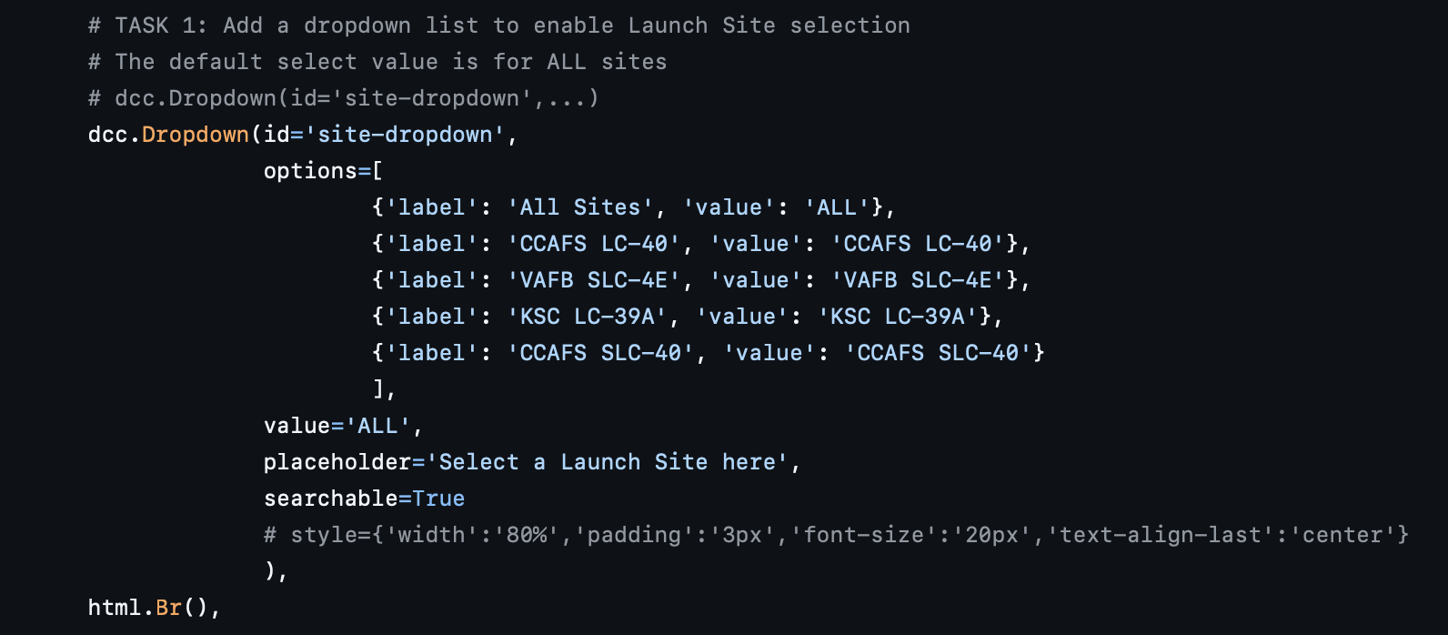
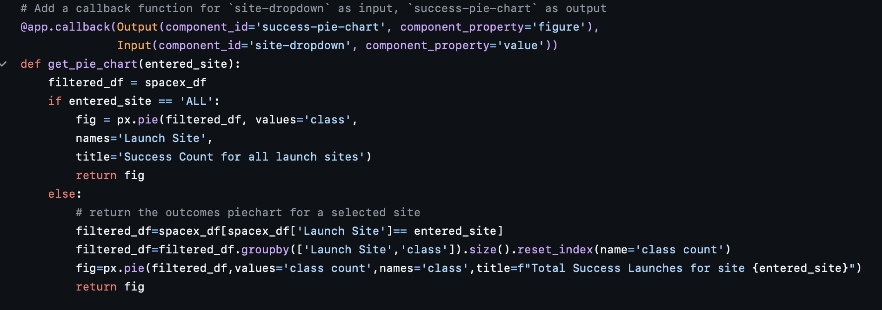
Build a Dashboard with Plotly Dash
I developed an interactive dashboard application using Plotly Dash by implementing the following features:
1. Added a drop-down input component to select a launch site.
2. Created a callback function that displays a success pie chart based on the selected launch site.
3. Incorporated a range slider to select the payload.
4. Developed a callback function to render a scatter plot of success versus payload.
https://github.com/adatheleader/falcon9/blob/main/spacex_dash_app.py

Slide 16
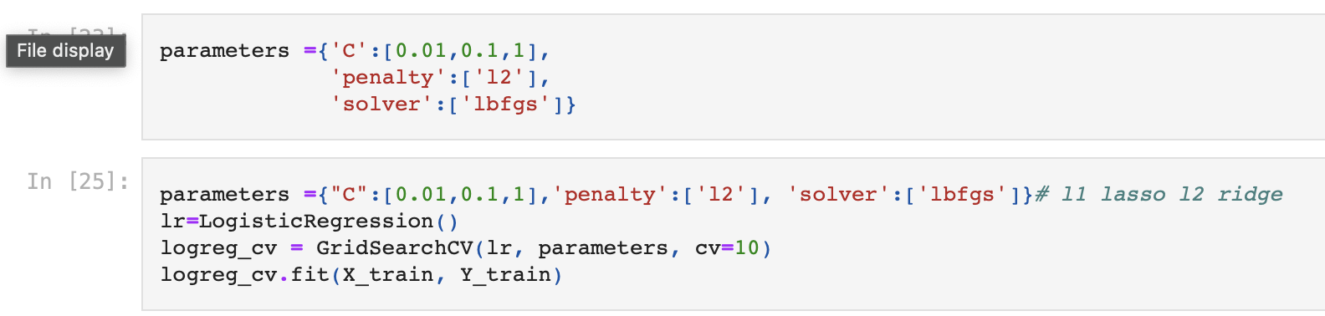
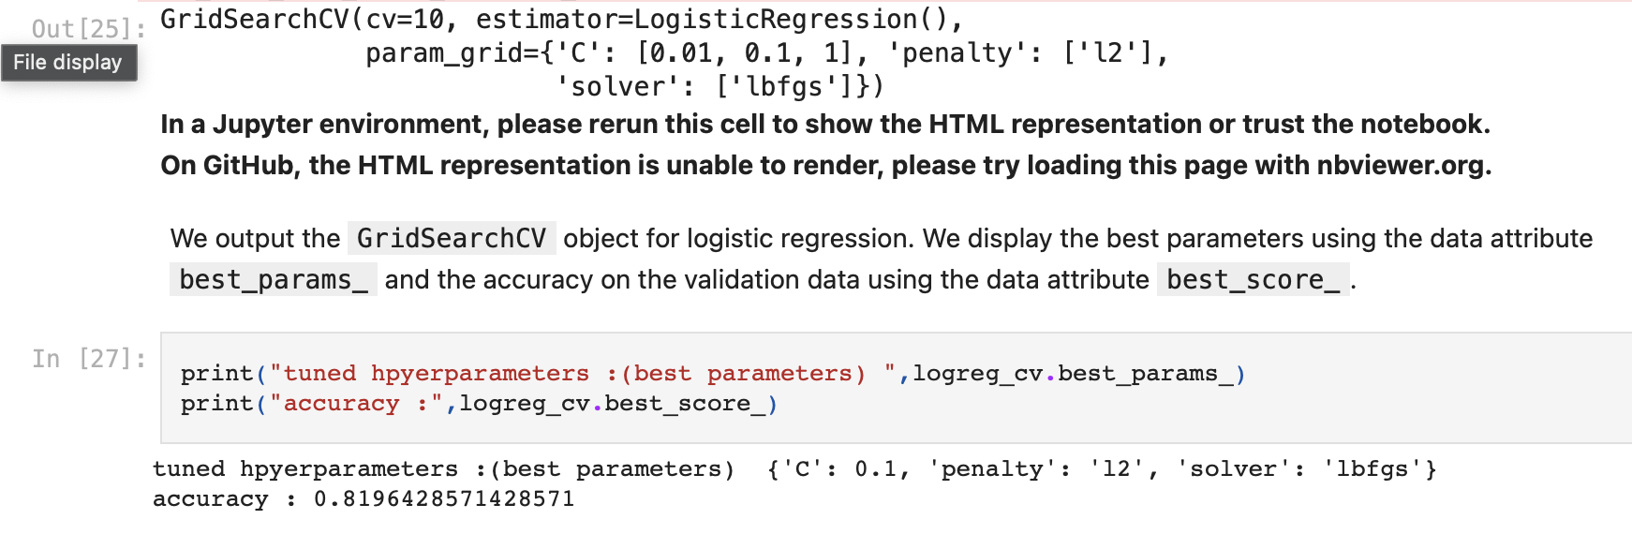
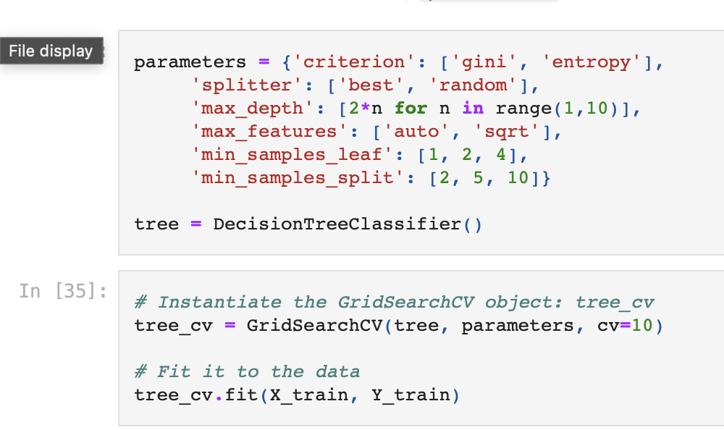
Predictive Analysis (Classification)
After loading the data as a Pandas DataFrame, I began conducting Exploratory Data Analysis and determining the training labels. I created a NumPy array from the 'Class' column in the data by applying the numpy() method and assigned it to the variable Y, which serves as the outcome variable.
Next, I standardized the feature dataset (X) by transforming it using the `preprocessing.StandardScaler()` function from Scikit-learn. After standardization, I split the data into training and testing sets using the `train_test_split` function from `sklearn.model_selection`, with the `test_size` parameter set to 0.2 and `random_state` set to 2.
To identify the best machine learning model that would perform best on the test data, I evaluated several algorithms: Support Vector Machines (SVM), Classification Trees, k-Nearest Neighbors, and Logistic Regression. For each algorithm, I created an object and then instantiated a `GridSearchCV` object, assigning a set of parameters for each model.
For each model under evaluation, I created the `GridSearchCV` object with `cv=10` and fit the training data into it to find the best hyperparameters. Once I fitted the training set, I output the `GridSearchCV` object for each model. I then displayed the best parameters using the `best_params_` attribute and the accuracy on the validation data using the `best_score` attribute.
Finally, I used the `score` method to calculate the accuracy on the test data for each model and plotted a confusion matrix for each one, comparing the test outcomes with the predicted results.
https://github.com/adatheleader/falcon9/blob/main/SpaceX-Machine-Learning-Prediction-Part-5-v1.ipynb

Slide 17

Section 2

Slide 18
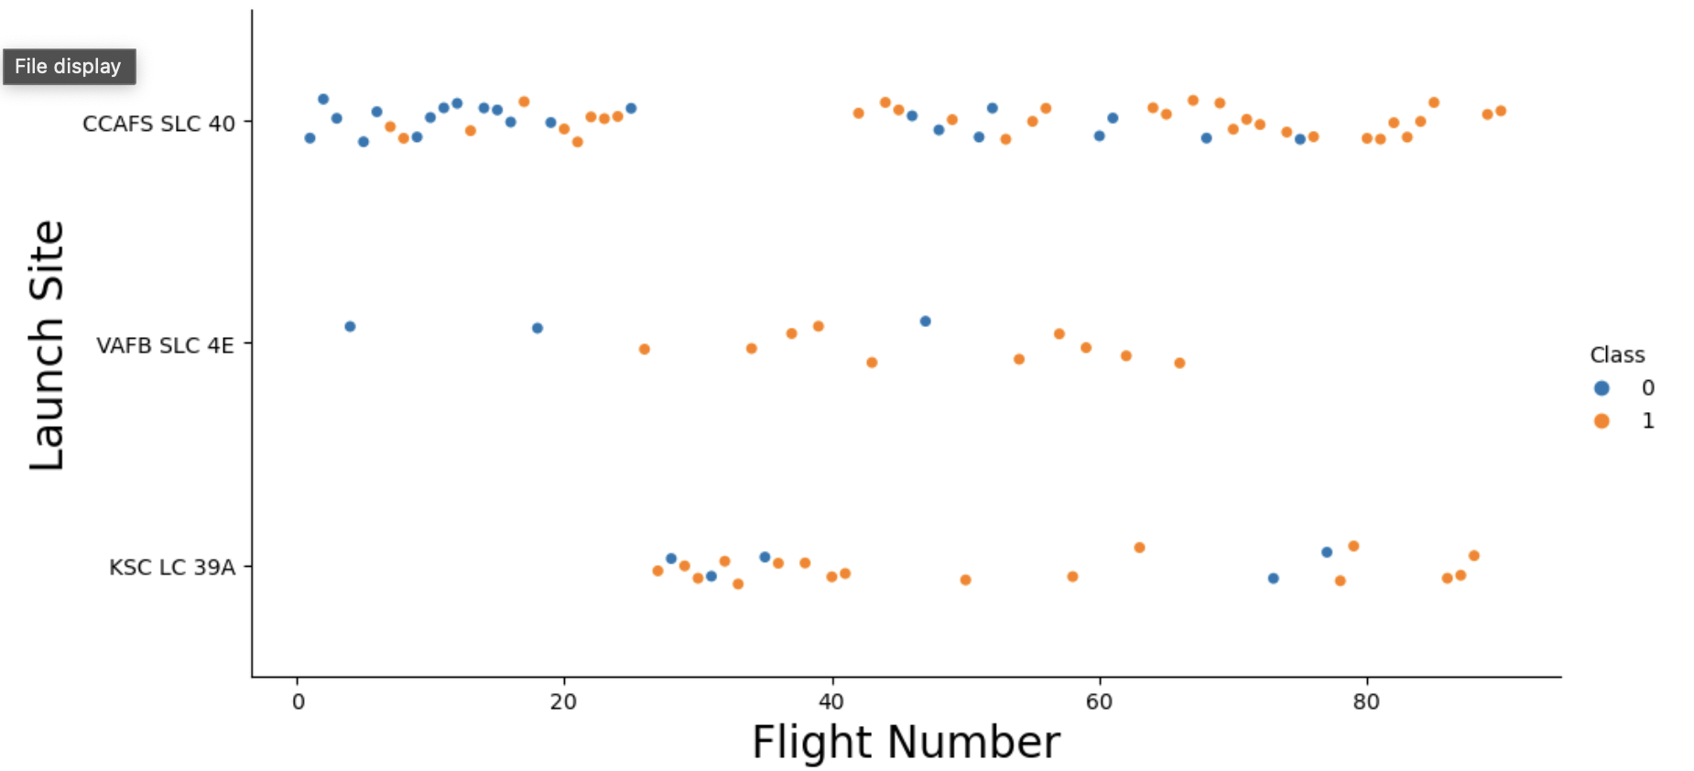
Flight Number vs. Launch Site

Slide 19
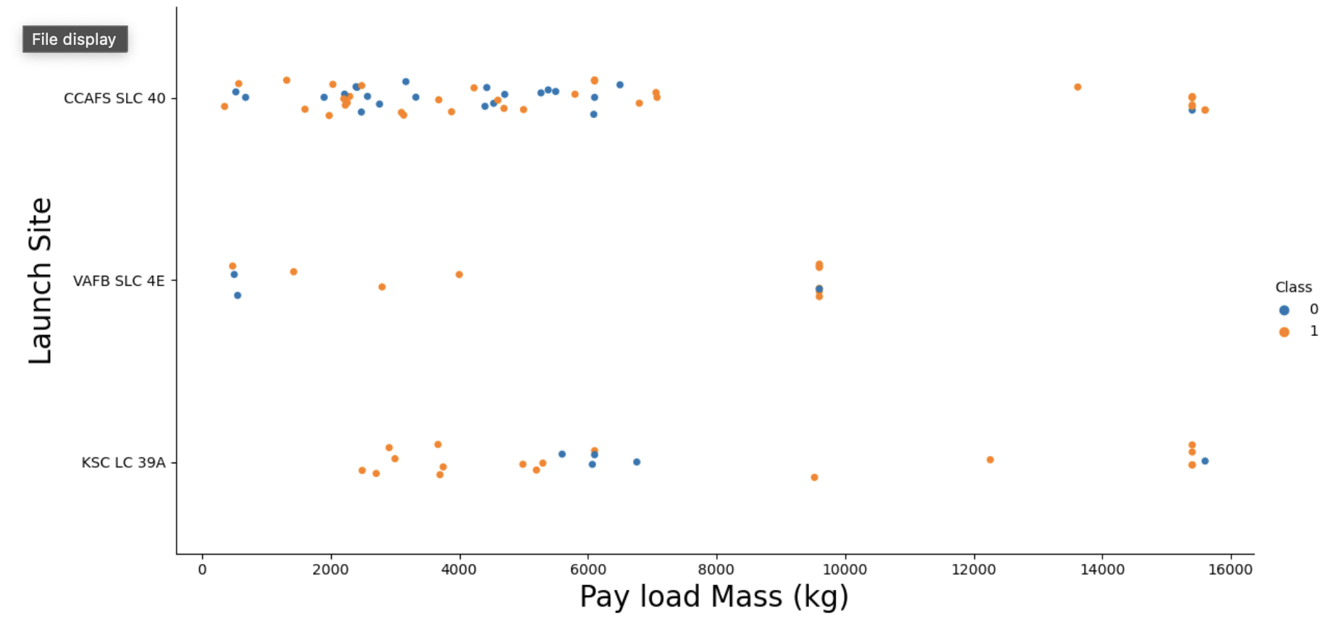
Payload vs. Launch Site
Now if you observe Payload Vs. Launch Site scatter point chart you will find for the VAFB-SLC launchsite there are no rockets launched for heavypayload mass(greater than 10000).

Slide 20
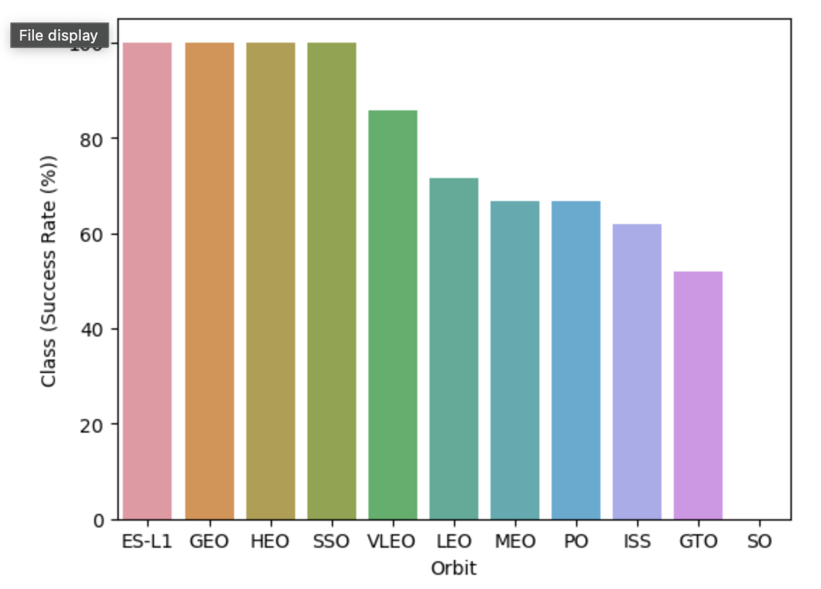
Success Rate vs. Orbit Type

Slide 21
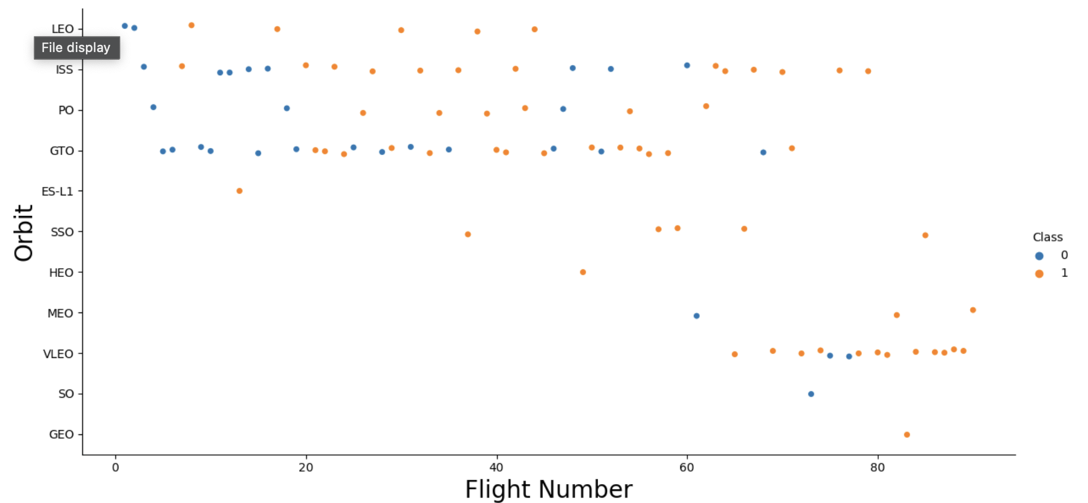
Flight Number vs. Orbit Type
You should see that in the LEO orbit the Success appears related to the number of flights; on the other hand, there seems to be no relationship between flight number when in GTO orbit.

Slide 22
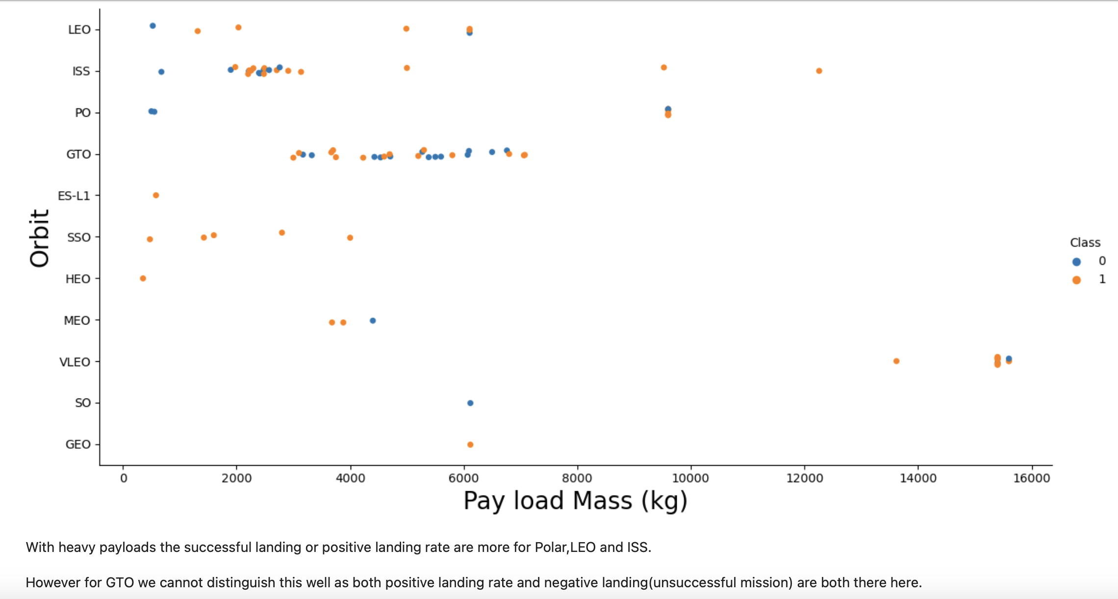
Payload vs. Orbit Type

Slide 23
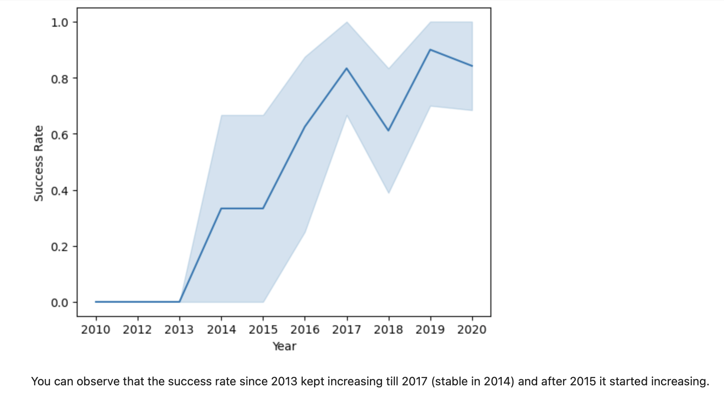
Launch Success Yearly Trend

Slide 24
All Launch Site Names
Used ‘SELECT DISTINCT’ statement to return only the unique launch sites from the ‘LAUNCH_SITE’ column of the SPACEXTBL table

Slide 25
Launch Site Names Begin with 'CCA'
Used ‘LIKE’ command with ‘%’ wildcard in ‘WHERE’ clause to select and dispay a table of all records where launch sites begin with the string 'CCA'

Slide 26
Total Payload Mass
Used the ‘SUM()’ function to return and display the total sum of ‘PAYLOAD_MASS_KG’ column for Customer ‘NASA(CRS)

Slide 27
Average Payload Mass by F9 v1.1
Used the ‘AVG()’ function to return and dispaly the average payload mass carried by booster version F9 v1.1

Slide 28
First Successful Ground Landing Date
Used the ‘MIN()’ function to return and display the first (oldest) date when the first successful landing outcome on ground pad ‘Success (ground pad) ’happened.

Slide 29
Successful Drone Ship Landing with Payload between 4000 and 6000
Used ‘Select Distinct’ statement to return and list the ‘unique’ names of boosters with operators >4000 and <6000 to only list booster with payloads btween 4000-6000 with landing outcome of ‘Success (drone ship)’.

Slide 30
Total Number of Successful and Failure Mission Outcomes
Used the ‘COUNT()’ together with the ‘GROUP BY’ statement to return total number of missions outcomes

Slide 31
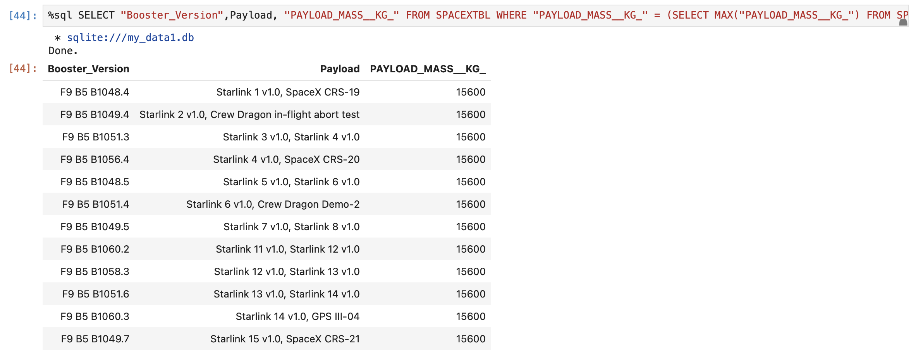
Boosters Carried Maximum Payload
Using a Subquerry to return and pass the Max payload and used it list all the boosters that have carried the Max payload of 15600kgs

Slide 32
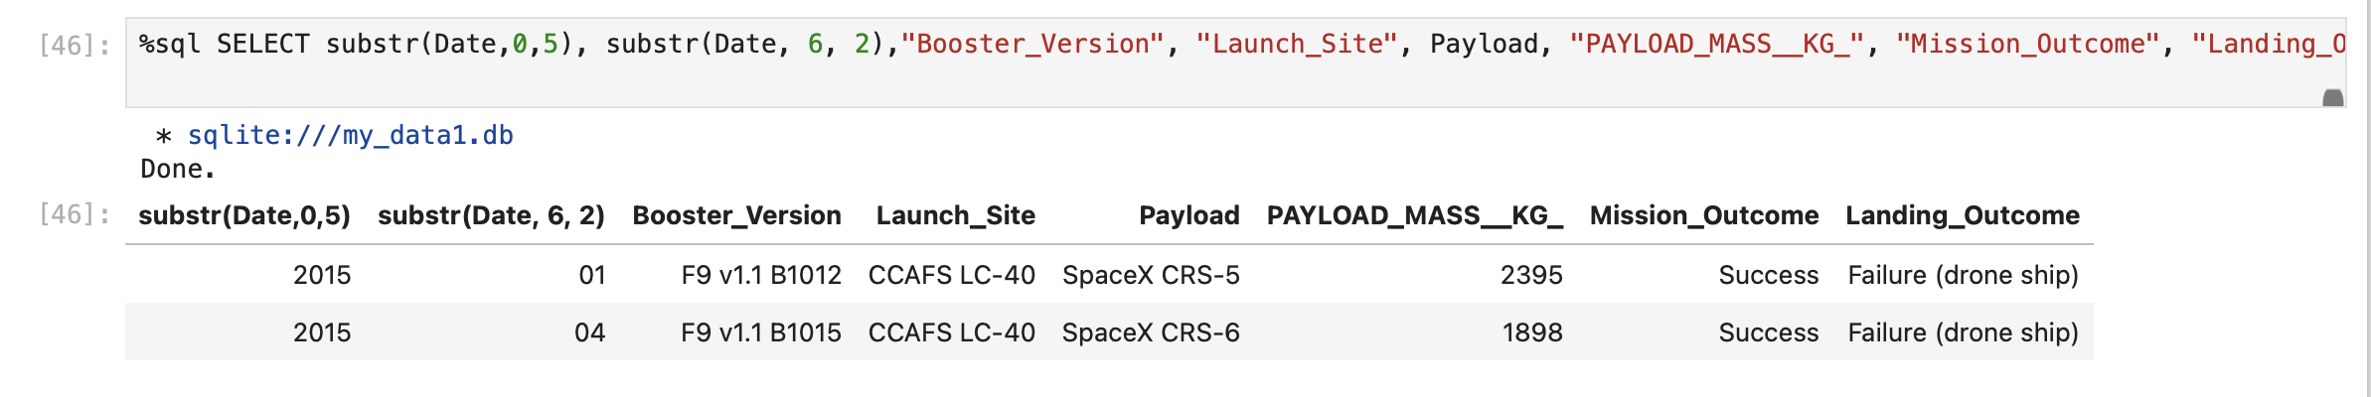
2015 Launch Records
Used the ‘subset ()’ in the select statement to get the month and year from the date column where substr(Date,7,4)='2015' for a year and Landing_outcome was ‘Failure (drone ship’) and return the records matching the filter.

Slide 33
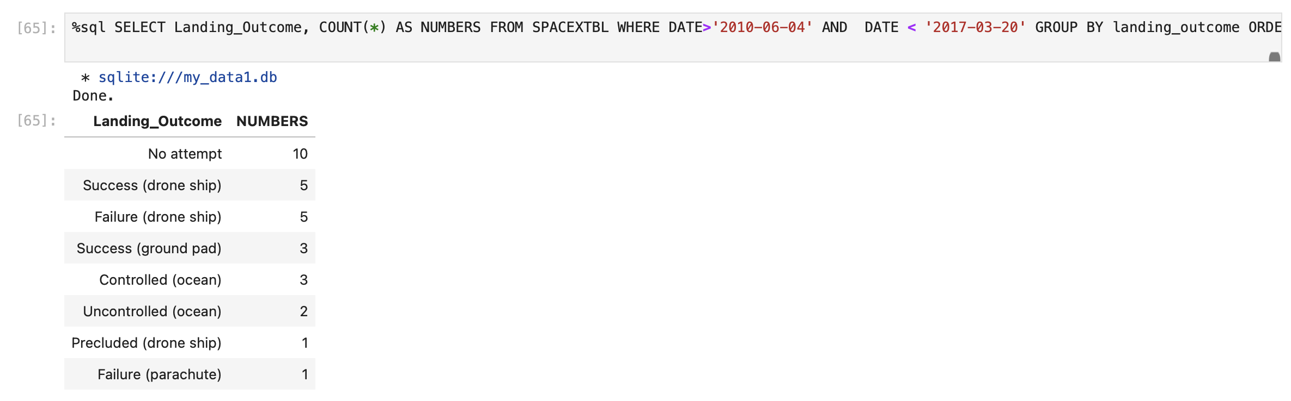
Rank Landing Outcomes Between 2010-06-04 and 2017-03-20
Rank the count of landing outcomes (such as Failure (drone ship) or Success (ground pad)) between the date 2010-06-04 and 2017-03-20, in descending order

Slide 34

Section 3

Slide 35
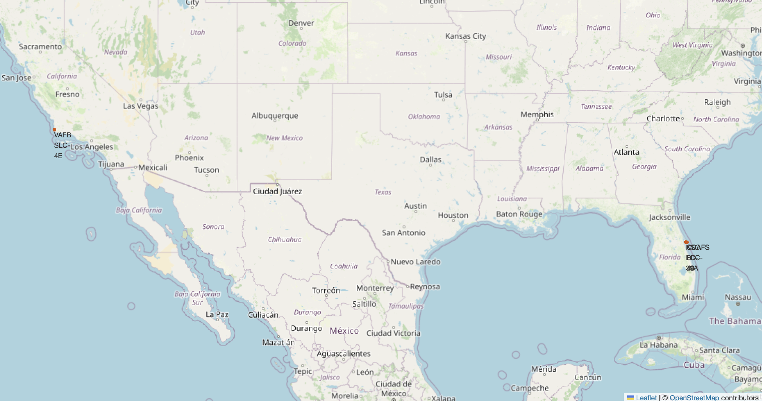
Mark all launch sites on a map
All launch sites are in proximity to the Equator, (located southwards of the US map). Also, all the launch sites are in very close proximity to the coast.

Slide 36
Mark the success/failed launches for each site on the map
In the Eastern coast (Florida) Launch site KSC LC-39A has relatively high success rates compared to CCAFS SLC-40 & CCAFS LC-40.

Slide 37
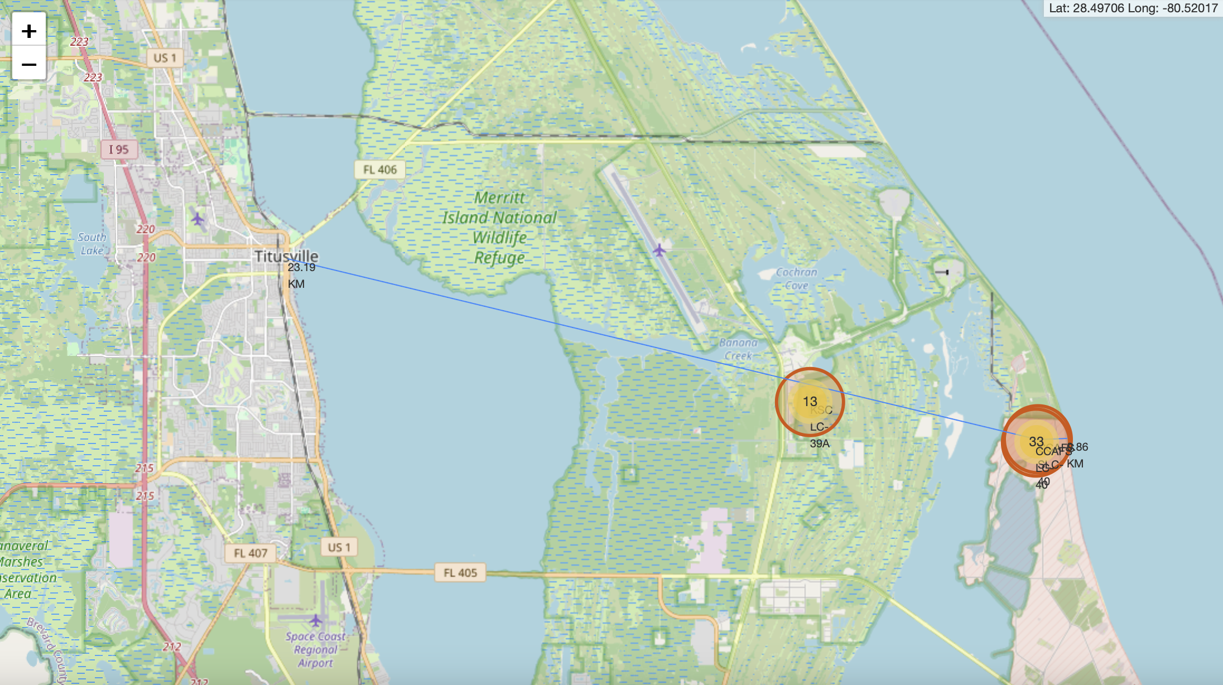
Calculate the distances between a launch site to its proximities
Launch site CCAFS SLC-40 closest to highway (Washington Avenue) is 23.19km

Slide 38

Section 4

Slide 39
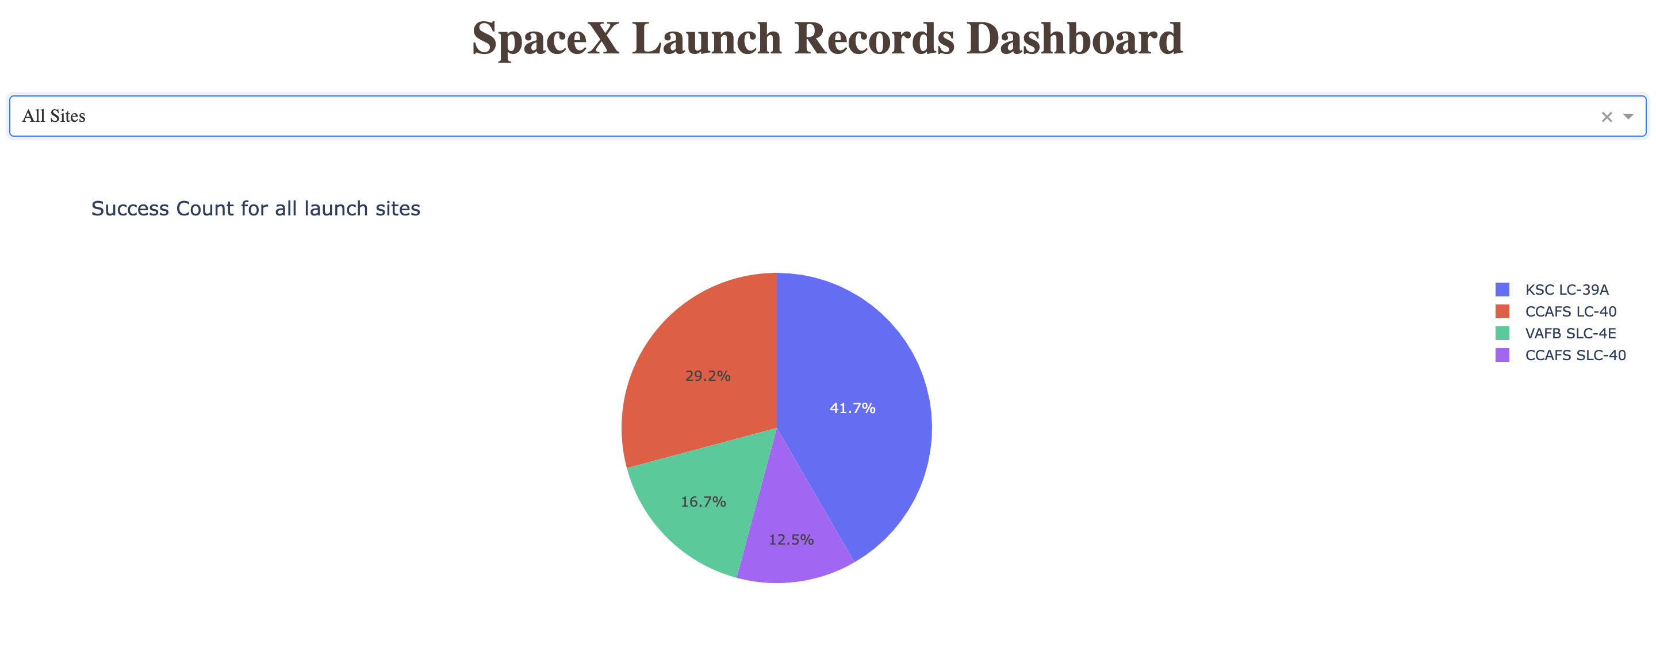
Launch success count for all sites, in a piechart
Launch site KSC LC-39A has the highest launch success rate at 42% followed by CCAFS LC-40 at 29%, VAFB SLC-4E at 17% and lastly launch site CCAFS SLC-40 with a success rate of 13%

Slide 40
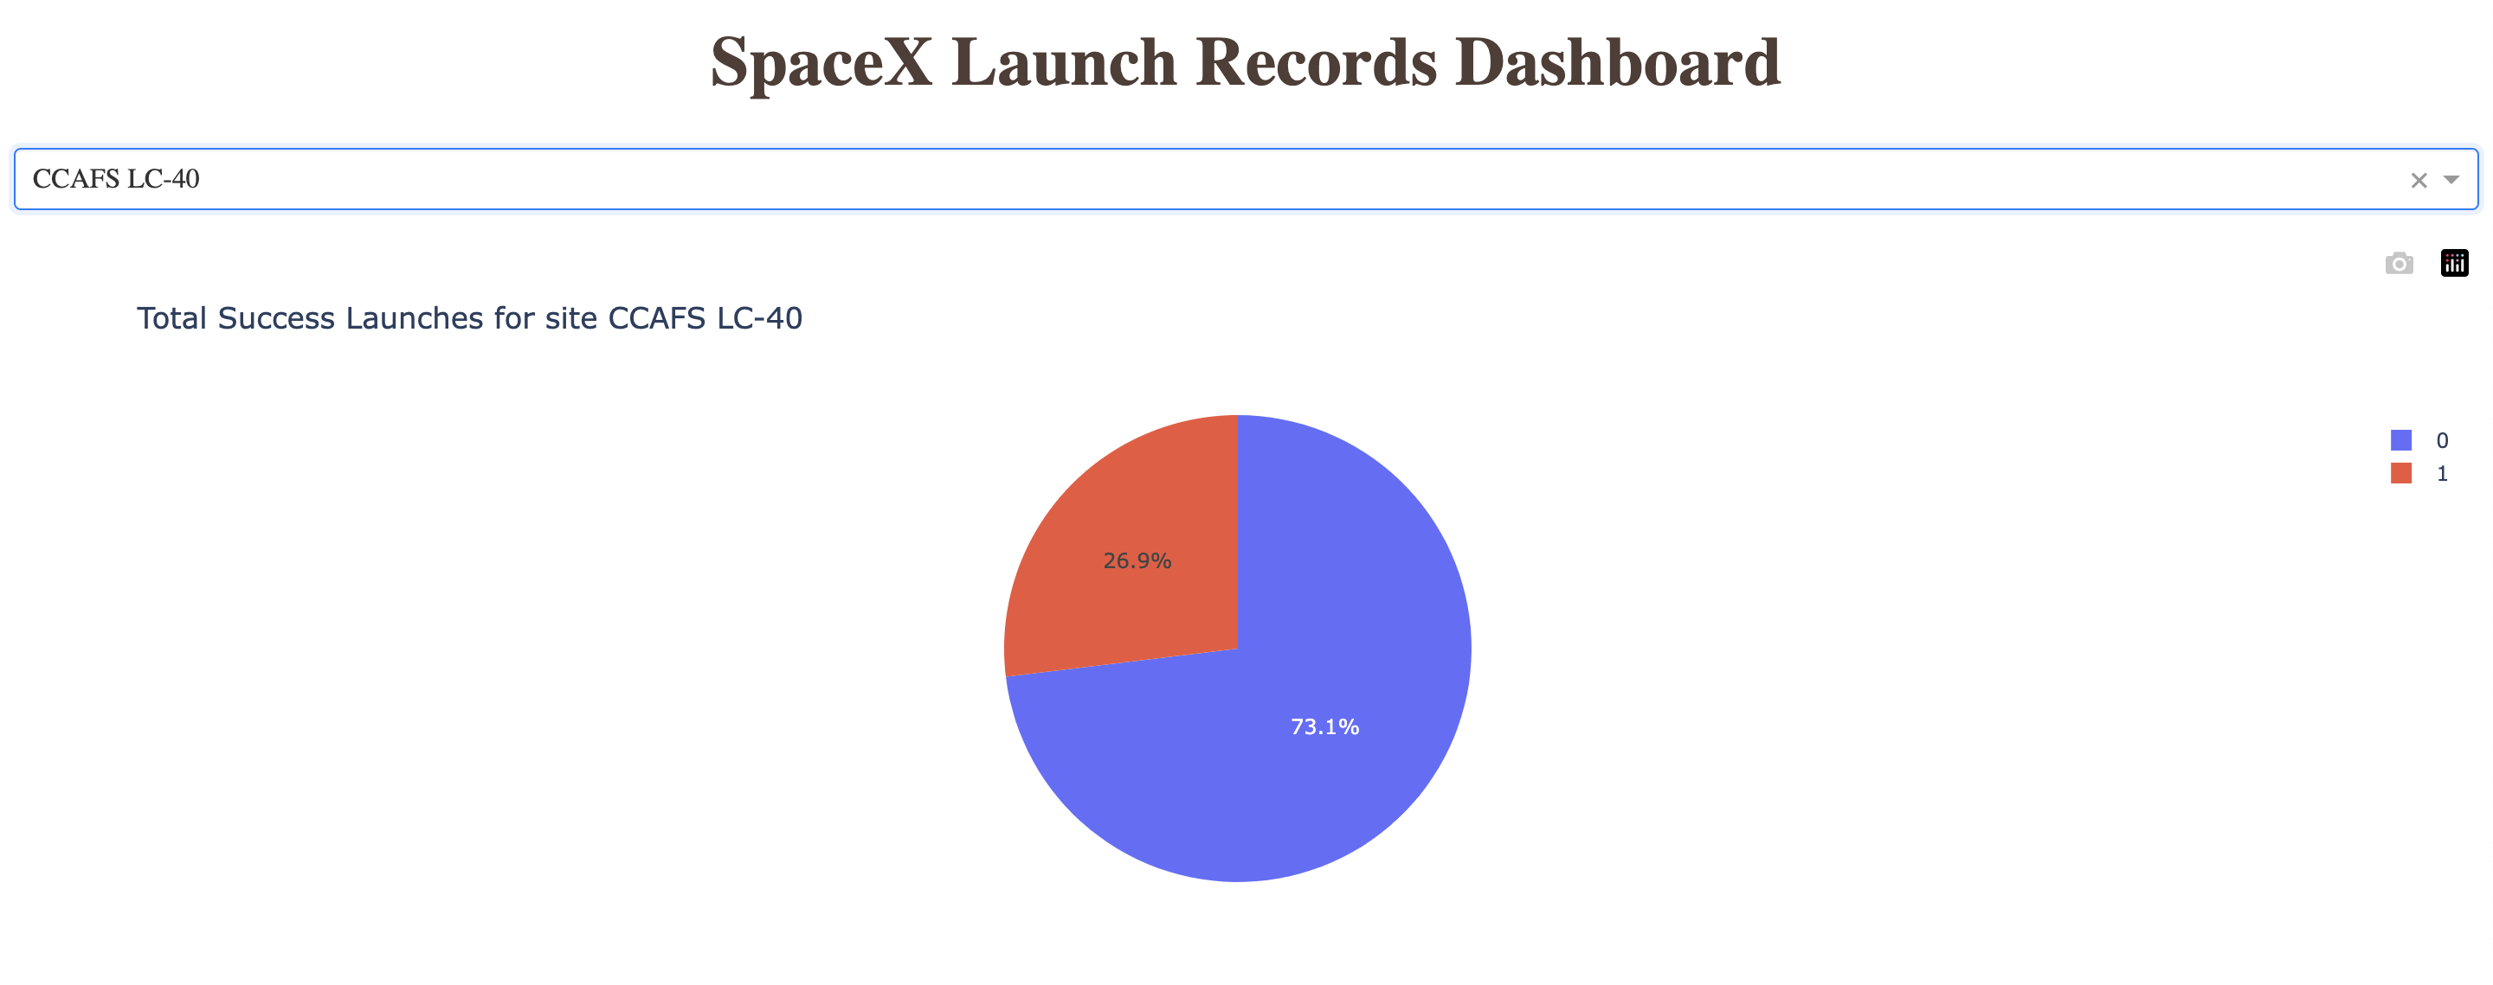
The piechart for the launch site with highest launch success ratio
Launch site CCAFS LC-40 had the 2nd highest success ratio of 73% success against 27% failed launches

Slide 41
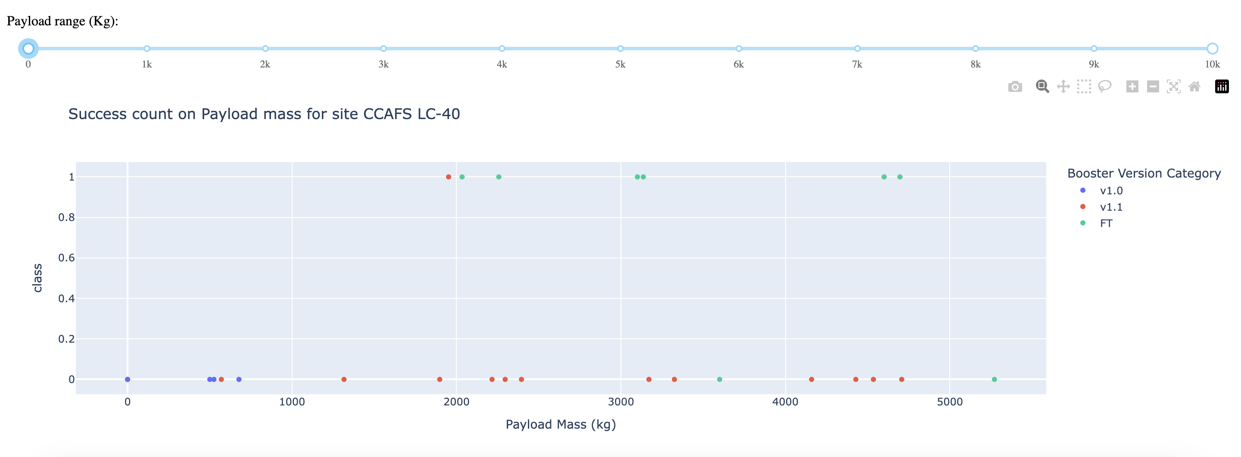
Payload vs. Launch Outcome scatter plot
For Launch site CCAFS LC-40 the booster version FT has the largest success rate from a payload mass of >2000kg

Slide 42

Section 5

Slide 43
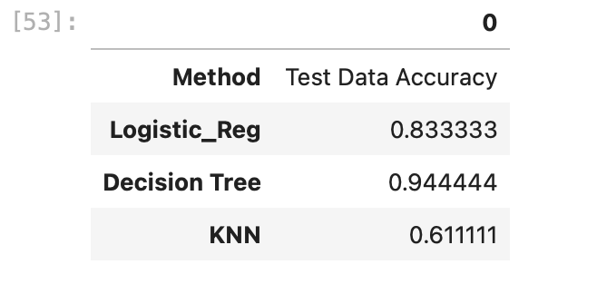
Classification Accuracy

Slide 44
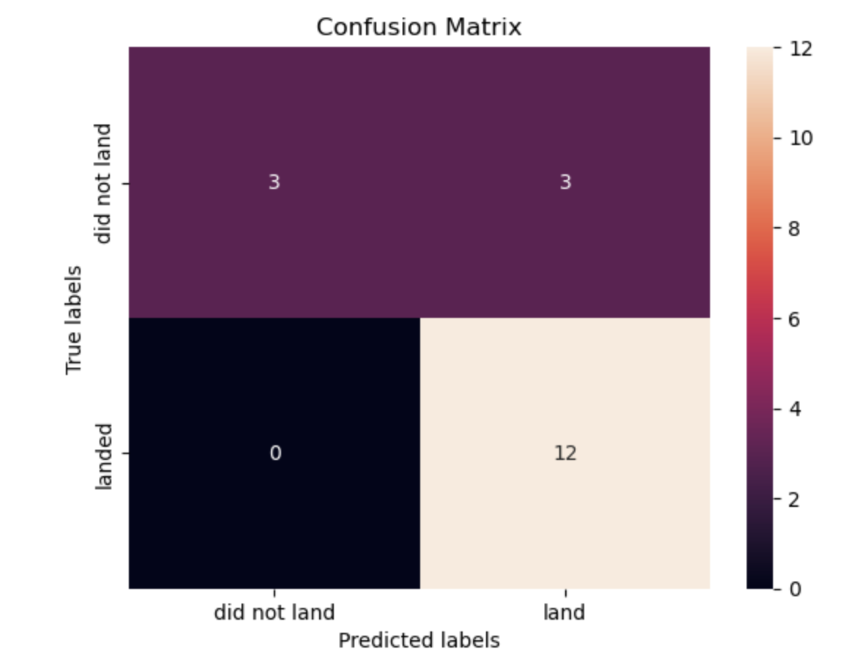
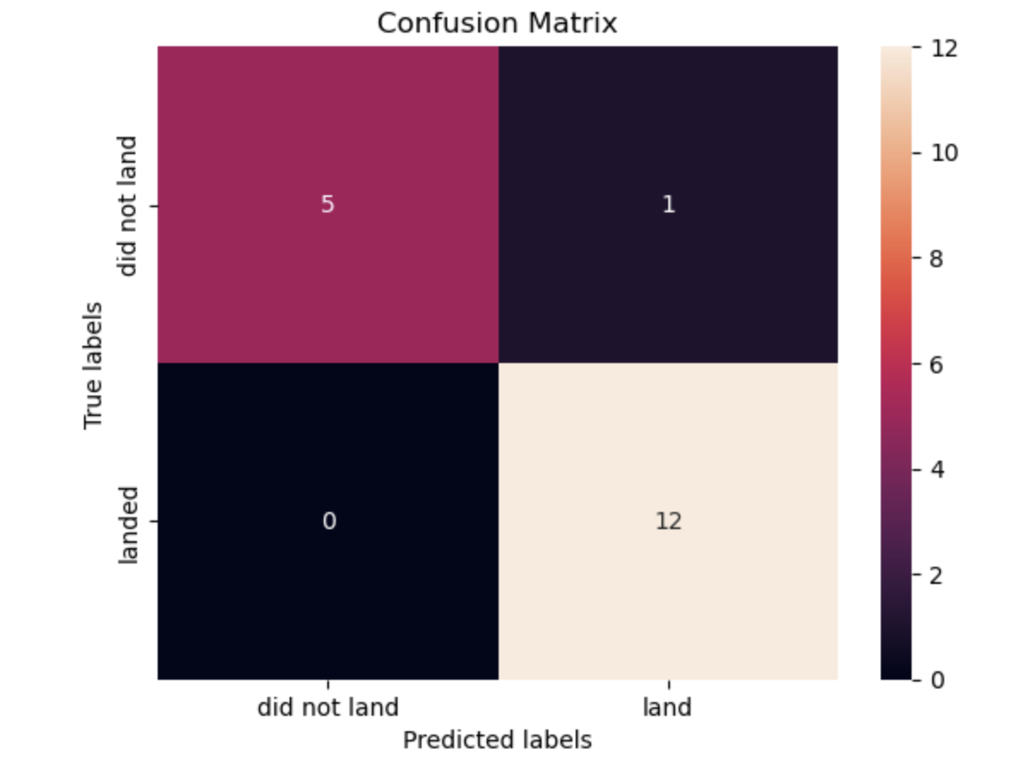
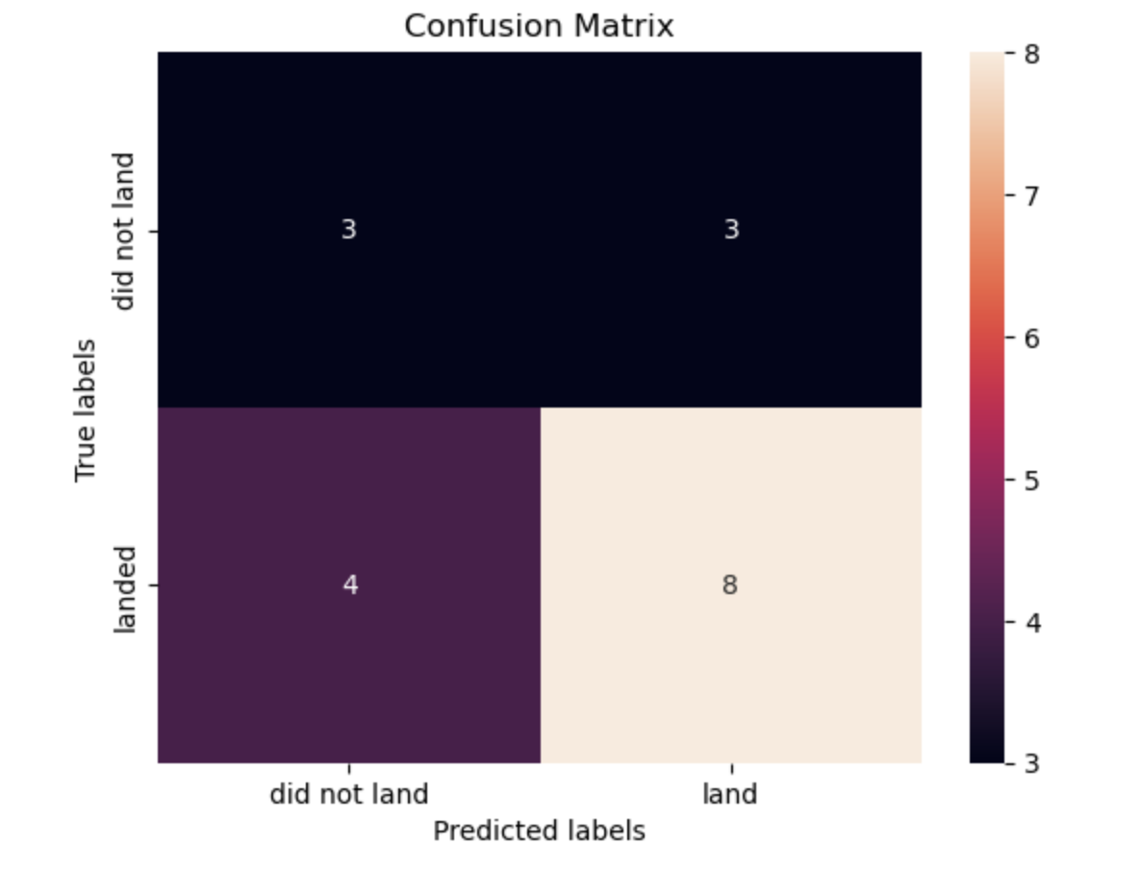
Confusion Matrix

Slide 45
Conclusions
Different launch sites have varying success rates. For instance, CCAFS LC-40 has a success rate of 60%, while KSC LC-39A and VAFB SLC-4E both have a success rate of 77%.
We can deduce that, as the number of flights increases at each of the three launch sites, so does the success rate. For example, the success rate for the VAFB SLC-4E launch site reaches 100% after the 50th flight. Both KSC LC-39A and CCAFS LC-40 achieve a 100% success rate after their 80th flight.
If you observe the Payload vs. Launch Site scatter plot, you'll find that there are no rockets launched for heavy payloads (greater than 10000) from the VAFB SLC-4E launch site.
The orbits ES-L1, GEO, HEO, and SSO exhibit the highest success rates at 100%, while the SO orbit has the lowest success rate at approximately 50%, with a few instances of 0% success.
In LEO orbit, success appears to be related to the number of flights; conversely, there seems to be no relationship between the flight number and success rates in GTO orbit.
For heavy payloads, successful landing rates are higher for Polar, LEO, and ISS orbits. However, in GTO orbit, we cannot clearly distinguish between positive landing rates and negative landings (unsuccessful missions).
Finally, the overall success rate has been steadily increasing since 2013, reaching its peak in 2020.

Slide 46


